Slide 1
Information Visualization First Prototype
G02-A
89519 – Pedro Elias
89533 – Raquel Santos
89546 –Tiago Afonso

Slide 2
visualization interface
01

Slide 3
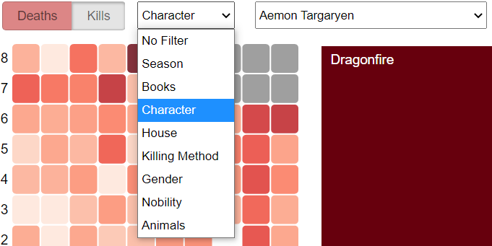
Overview
“Deaths/Kills” button
Filter menu

Slide 4
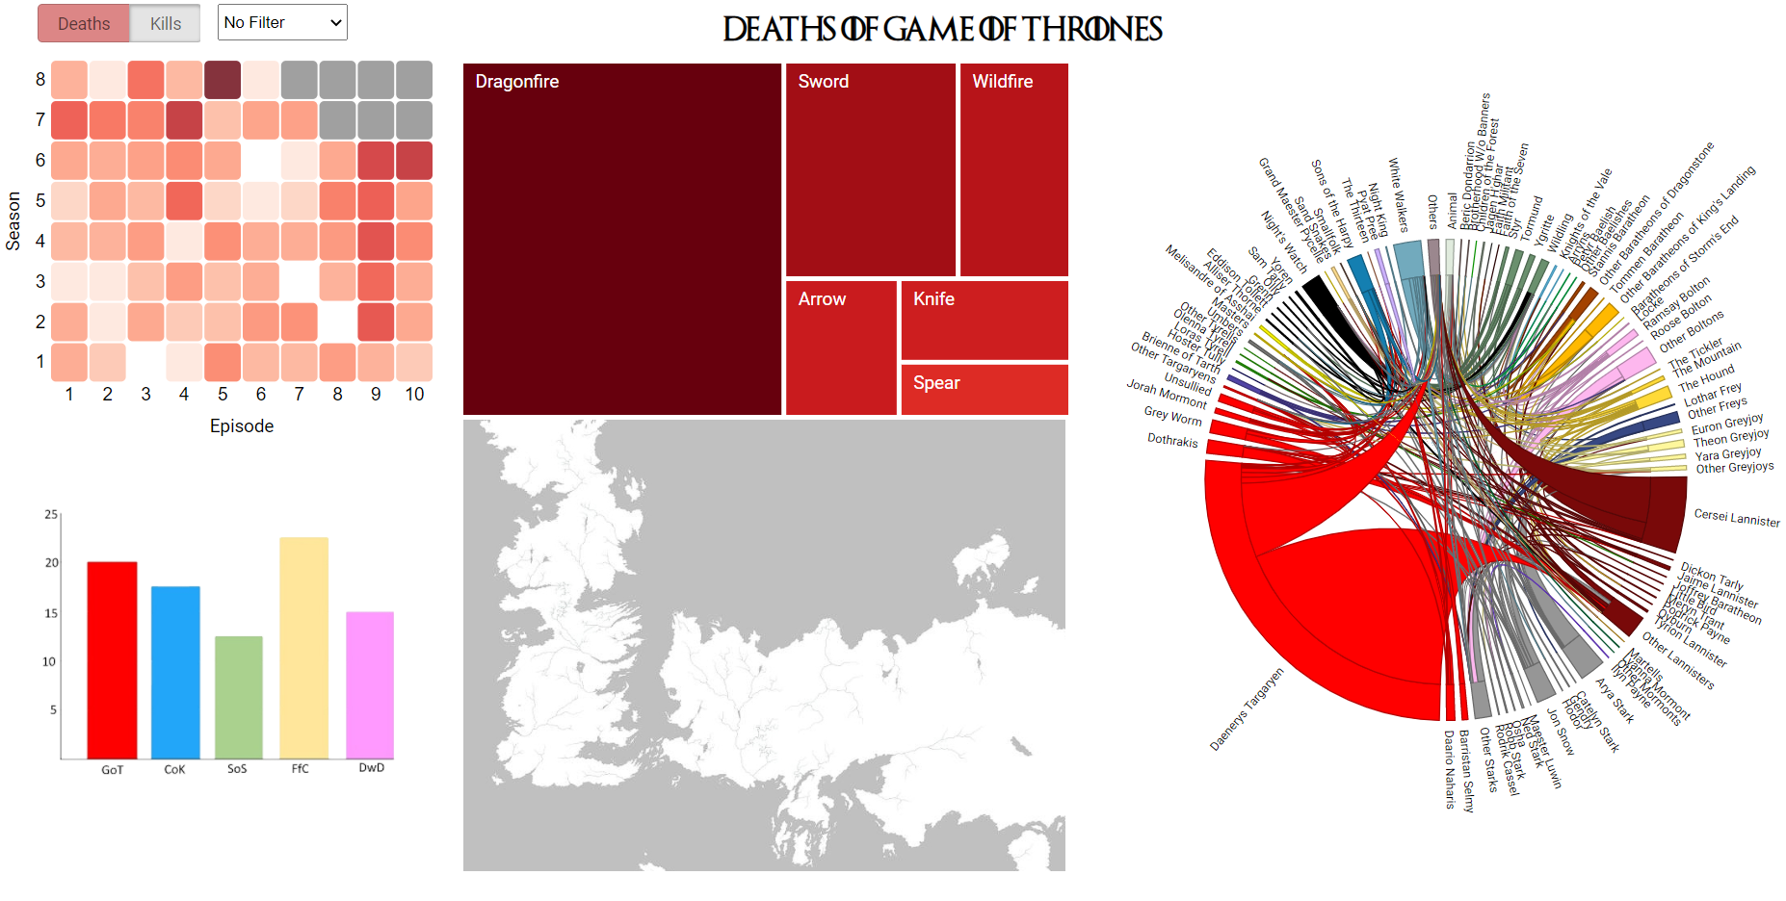
Overview
5 idioms

Slide 5
two idioms
02

Slide 6
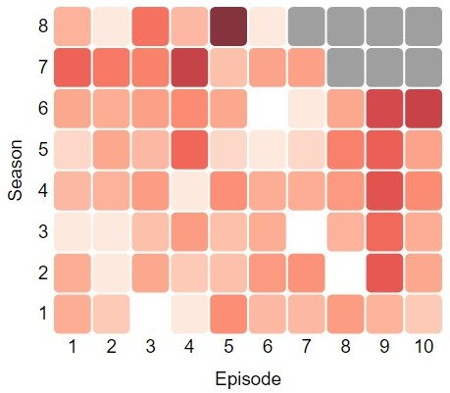
Heatmap

Slide 7
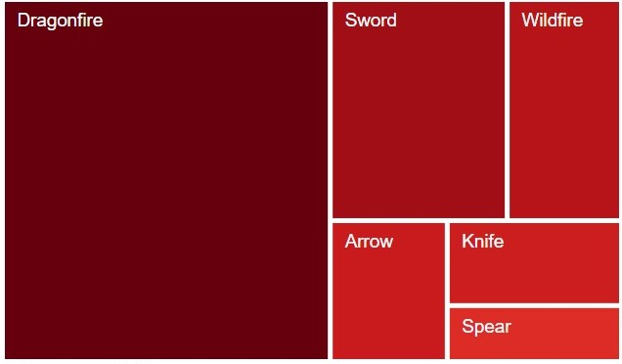
Treemap

Slide 8
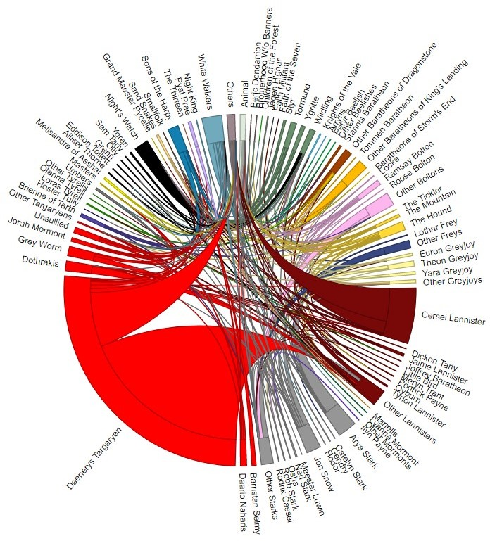
Chord diagram

Slide 9
Video
03

Slide 10
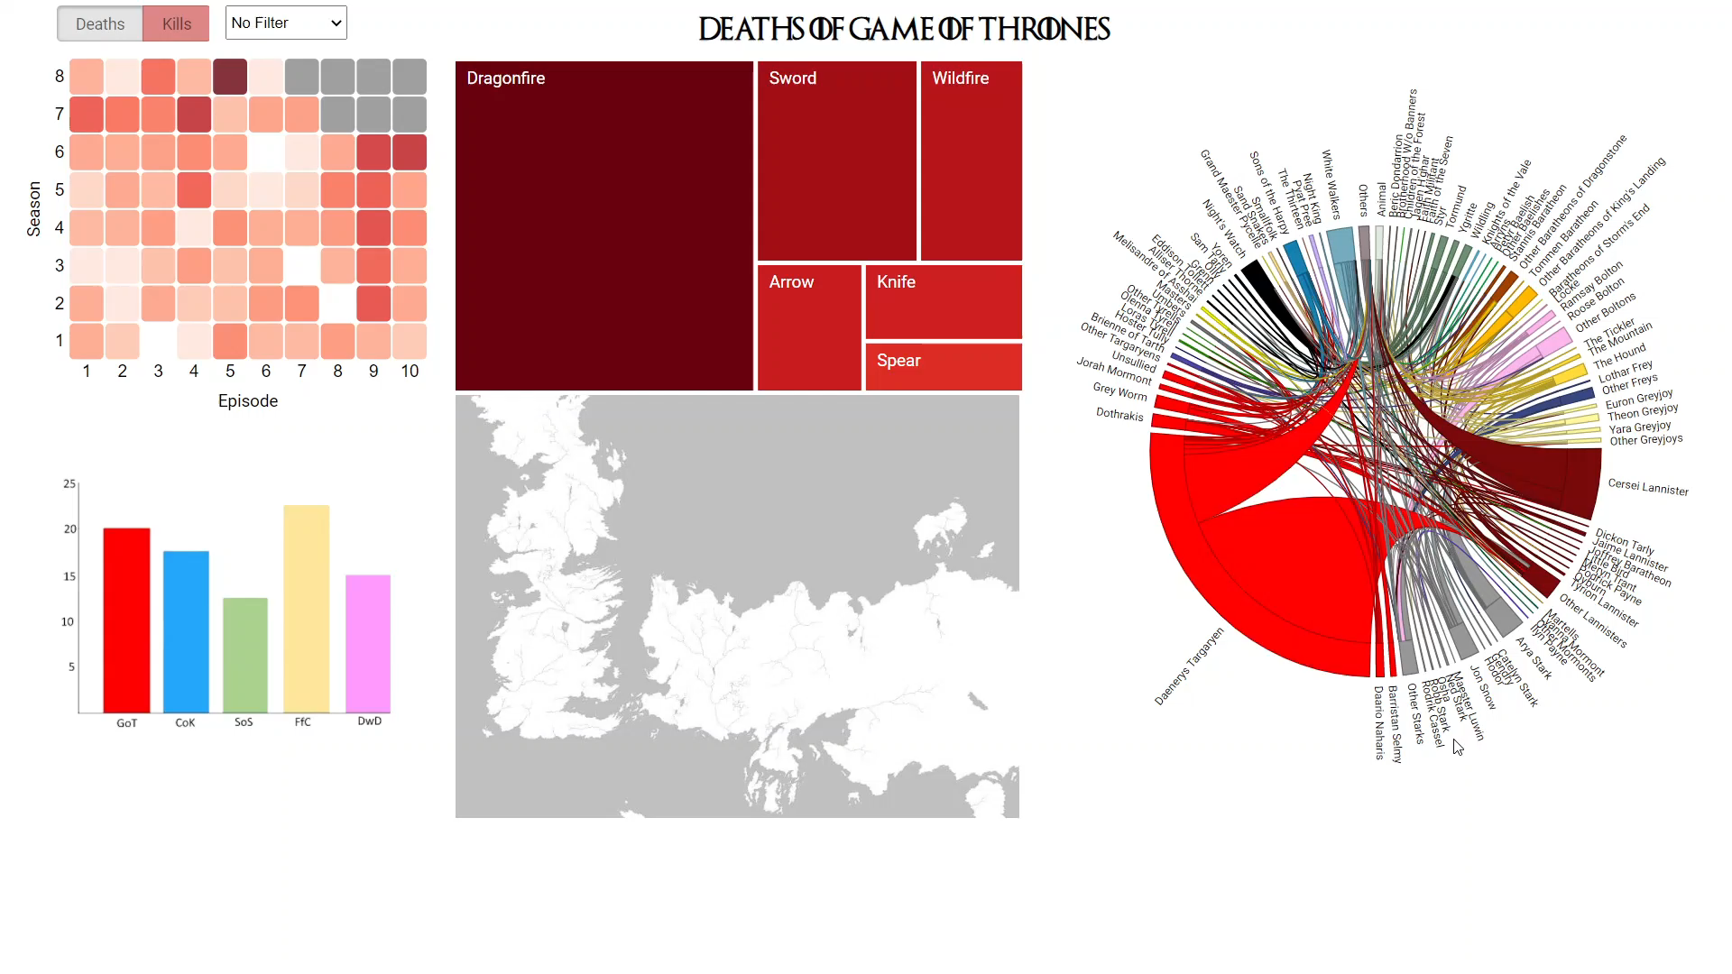
Video

Slide 11
Explanation
04

Slide 12

Explanation
Each idiom highlights
a different attribute
Visualize all the data
Interactive
Best topic!

